Slide 1
A mathematical argument
It is…
A sequence of statements and reasons given with the aim of demonstrating that a claim is true or false
It is not…
Solely an explanation of what you did (steps)
A recounting of your problem solving process
Explaining why you personally think it’s true for reasons that are not necessarily mathematical (e.g., popular consensus; external authority, etc. It’s true because John said it, and he’s always always right.)

Slide 2
Goal of a Mathematical Argument
Is to demonstrate a claim is true or false for any mathematical statement, there can be multiple approaches to composing an argument.

Slide 3
Multiple Approaches to Composing an Argument
Narrative (Angel)
Pictorial (Roland)
Symbolic (algebraic)
Consecutive numbers can be represented as n and n+1.
Adding these, we get n+(n+1)=2n+1.
2n+1 is odd because there’s one left over when you divide by 2.
Example based (Micah)

Slide 4
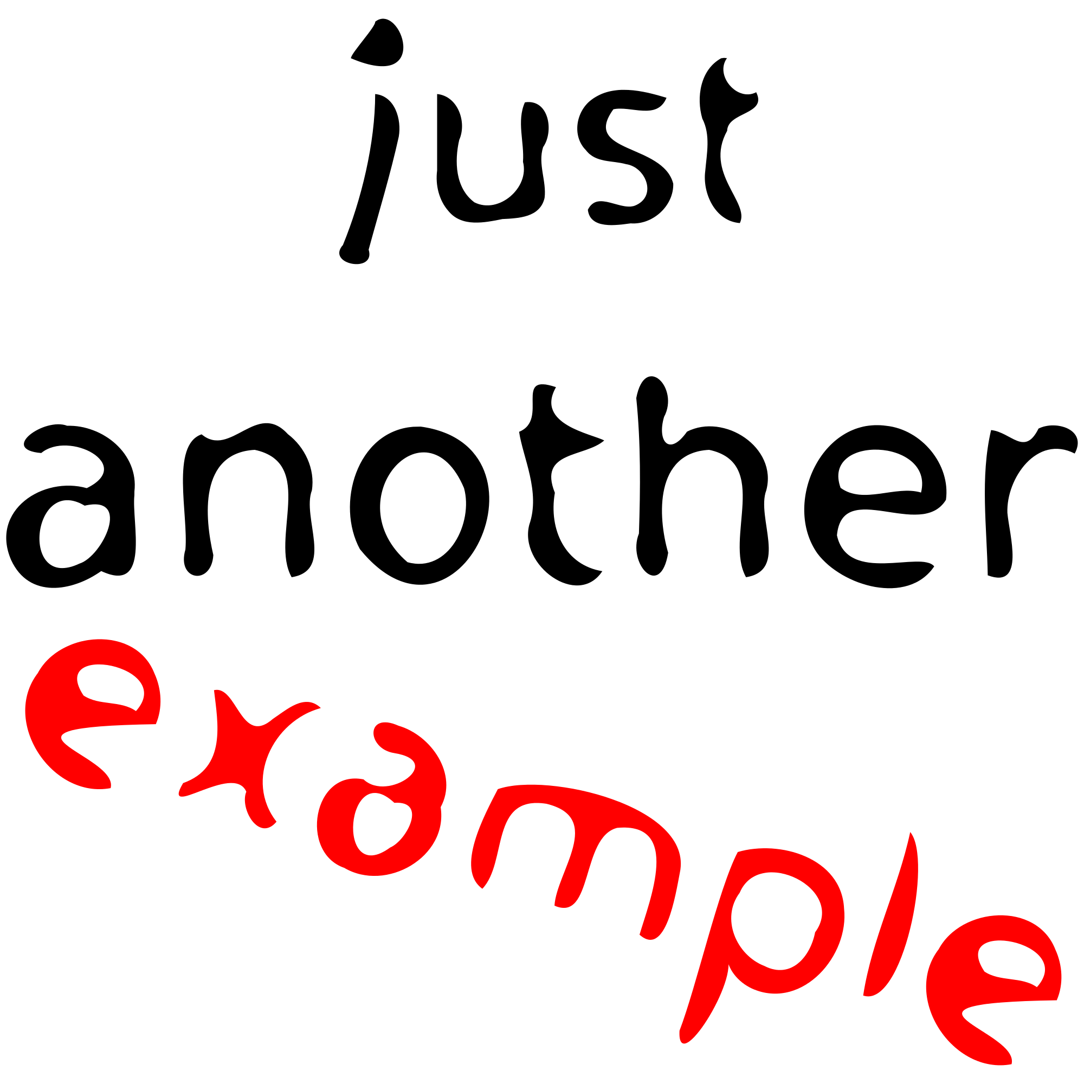
Example based (Micah)
An empirical approach can be used in some arguments, but is not a good approach when trying to show a claim is true for all number, or all events, or all odd, etc. (such as with this sum of two consecutive number problem)

Slide 5
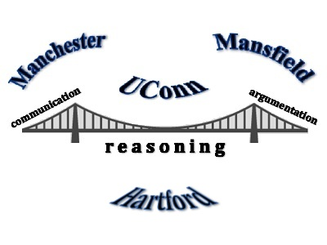
Thank You!

