Slide 1
Module 1: Mathematical Argumentation
Part 2: Mathematical Argumentation in the Classroom

Slide 2
Welcome
Module 1: Part 2
In this section, we will take what we’ve learned about mathematical argumentation and look at it in the classroom context.
Classroom
Argumentation
Notes:
Welcome to Module 1 Part 2. In this section, we will take what we’ve learned about mathematical argumentation and look at it in the classroom context.
In this module, we’ll hear from teachers about how argumentation supports their work and why they find it a valuable practice in their classrooms. We’ll also look at a classroom video where two students are engaged in argumentation. The video helps us see both how argumentation can support developing conceptual understandings as well as some important aspects of how to support students participation in argumentation.

Slide 3
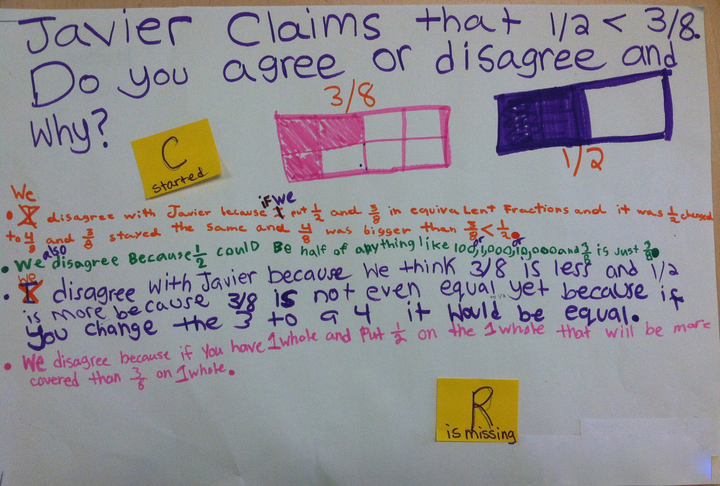
Goals:
Module 1: Part 2
connect argumentation to the classroom context by analyzing student arguments
expand your thinking about argumentation in relation to your own practice
Notes:
By the end of this part of the module, we hope that we have helped you connect argumentation to the classroom context by analyzing student arguments
And
We how that you will have expanded your thinking about argumentation in relation to your own practice

Slide 4
What is a mathematical argument?
Module 1: Part 2
A mathematical argument is a sequence of statements and reasons given with the aim of demonstrating that a claim is true or false.
Notes:
Let’s briefly revisit some definitions established in Module 1 part 1.
A mathematical argument is…
Recall also that argumentation involves a host of different activities. It’s not likely to succeed if you just say: here students, create an argument to show xxxx. The process of argumentation is what leads them to be able to articulate the claim they think is true and express why they think it is true.

Slide 5
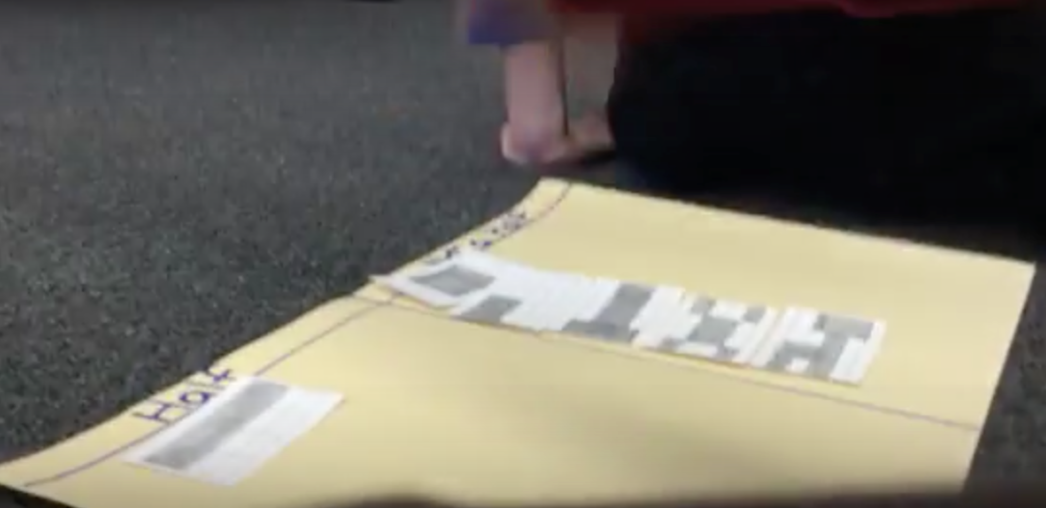
In this module
Module 1: Part 2
Teachers on the value of argumentation
Video– how might argumentation support conceptual understanding?
Secondary task with student work
Connecting to practice
Notes:
…
…. For each clip, we have some guiding questions to help focus your reflection and conversation
Some commentary by us about the videos
Finally, there is a set of student work samples from HS students – along with some commentaries – for those of you who are secondary teachers. The video is relevant for all levels, but it’s also nice to see some of the mathematics your own students might work on.
We conclude with some questions that might help you link argumentation to your practice and start
ORIGINAL BULLETS ON SLIDES:
Teachers on why they value argumentation in their classrooms
Classroom videos of students engaged in argumentation – how does argumentation support conceptual understanding?
Secondary task with student work
Connecting to practice

