Slide 1
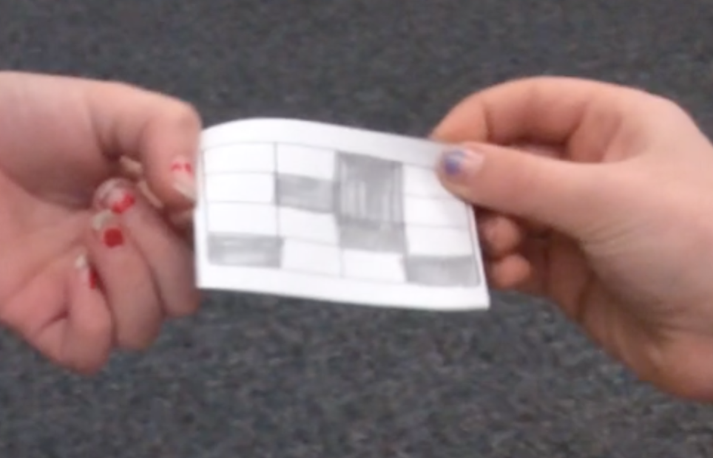
Argumentation in Action
Module 1: Part 2
Is It A Half?

Slide 2
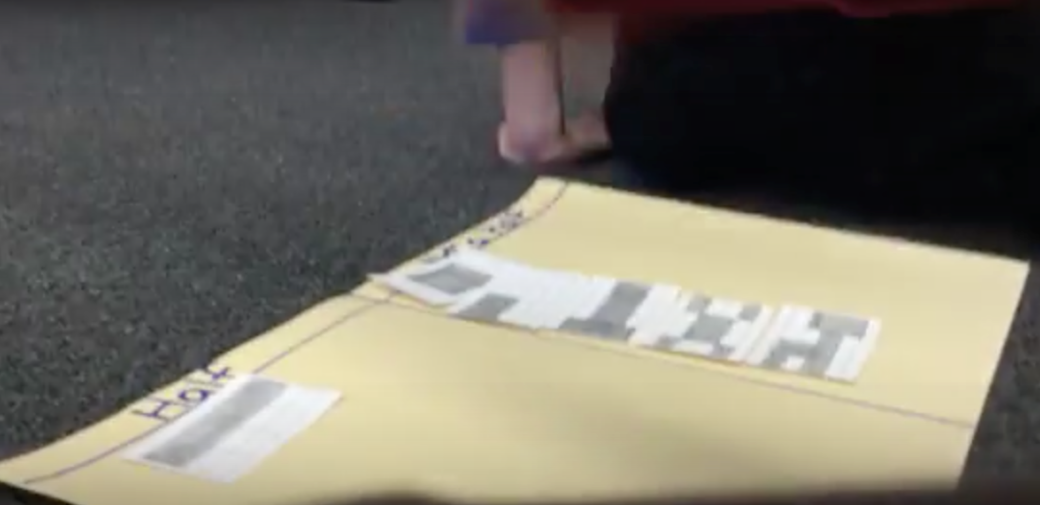
In this module
Module 1: Part 2
YOU ARE HERE!
Teachers on the value of argumentation
Video– how might argumentation support conceptual understanding?
Secondary task with student work
Connecting to practice
Notes:
…
…. For each clip, we have some guiding questions to help focus your reflection and conversation
Some commentary by us about the videos
Finally, there is a set of student work samples from HS students – along with some commentaries – for those of you who are secondary teachers. The video is relevant for all levels, but it’s also nice to see some of the mathematics your own students might work on.
We conclude with some questions that might help you link argumentation to your practice and start
ORIGINAL BULLETS ON SLIDES:
Teachers on why they value argumentation in their classrooms
Classroom videos of students engaged in argumentation – how does argumentation support conceptual understanding?
Secondary task with student work
Connecting to practice

Slide 3
What’s in here? What should I do?
Module 1: Part 2
**Do the Task! Is it a half? (doc)
Short Guide on Viewing videos (ppt mov)
Background information on the task (doc)
**Clip 1: Prior conceptions of a half (mov)
**Clip 2: Extending conceptions of a half (mov)
Clips 3a, 3b, 3c: Developing & refining
strategies (mov)
Transcripts (doc)
**Guiding and Reflection questions (doc)
**Summary Commentary (ppt, mov)
Notes:
Clip 1: 2.5 mins
Clip 2: another 2.5 mins clips
Clips 3a, 3b, 3cOver the next 7 mins or so == each about 30 seconds each

Slide 4
Questions for Viewing Clips
Module 1: Part 2
Guiding Questions
Reflection Questions
As you watch, listen for the students’ ideas. How are they understanding what half is?
What is the role of argumentation at this point in the lesson?
Reflect on questions a & b.
What might the teacher do next? How might she, or you, support these two students in sorting through and extending their ideas about ½?
Notes:
Note there’s a word doc with these.

Slide 5
Argumentation in Action
Module 1: Part 2
Is It A Half?

